Slide 1
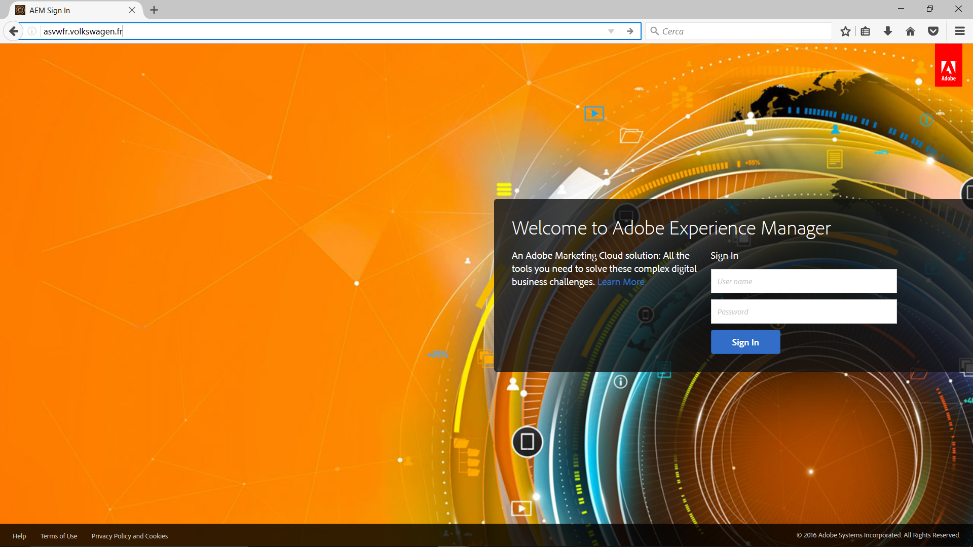
Login

Slide 2
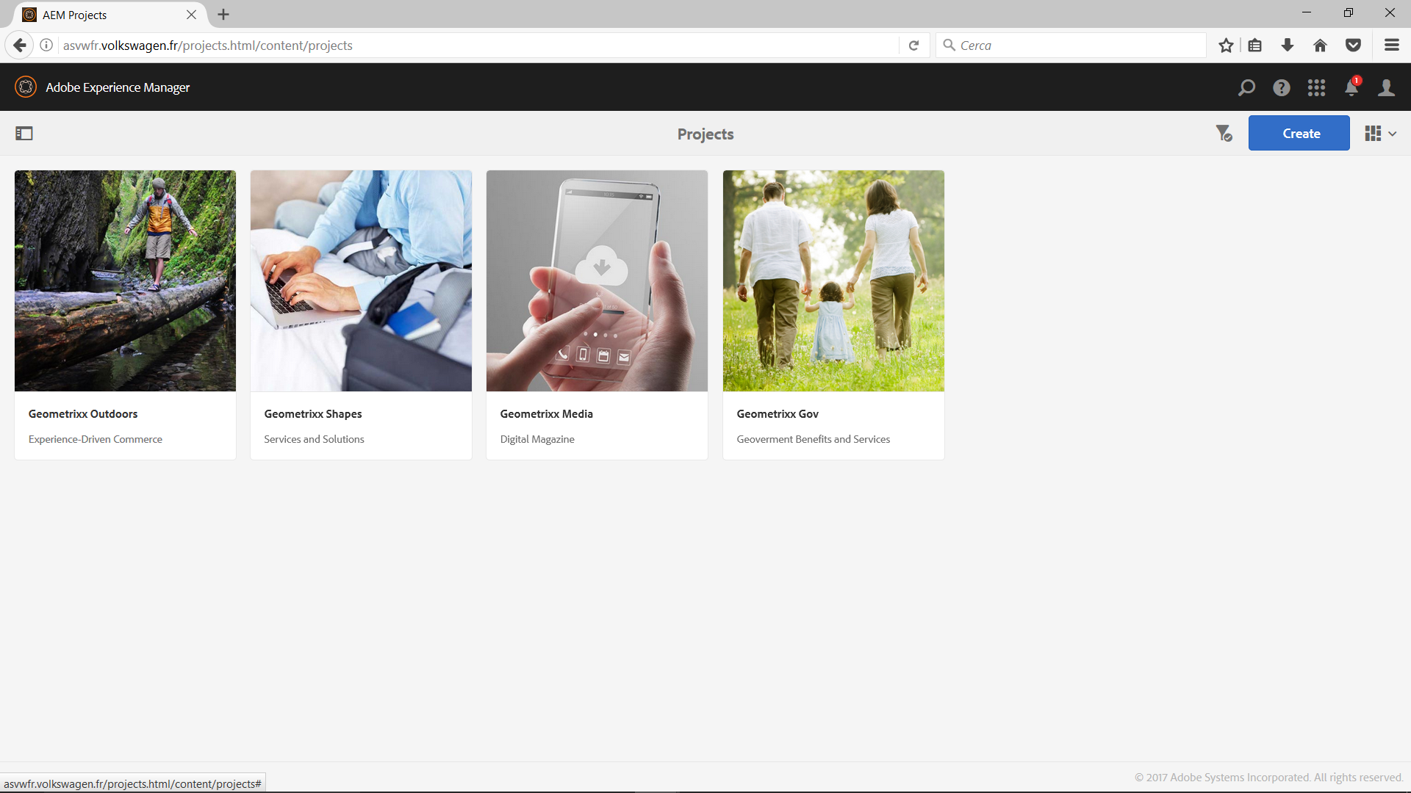
Click
Login

Slide 3
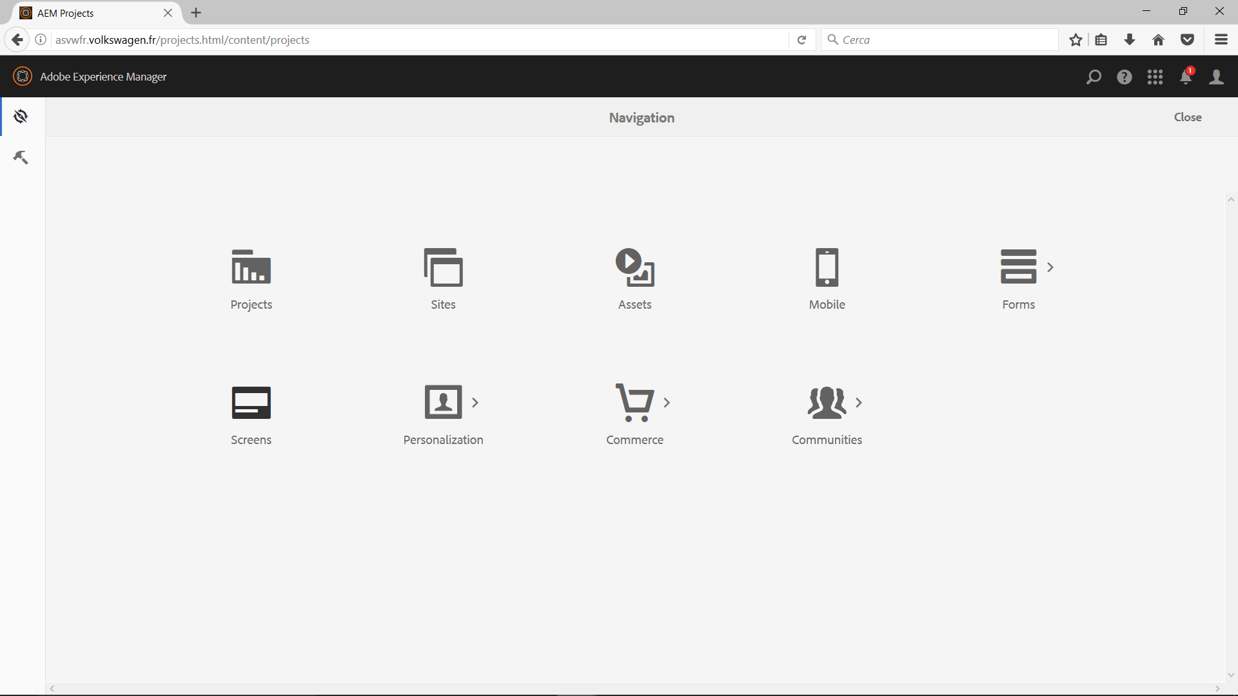
Click

Slide 4
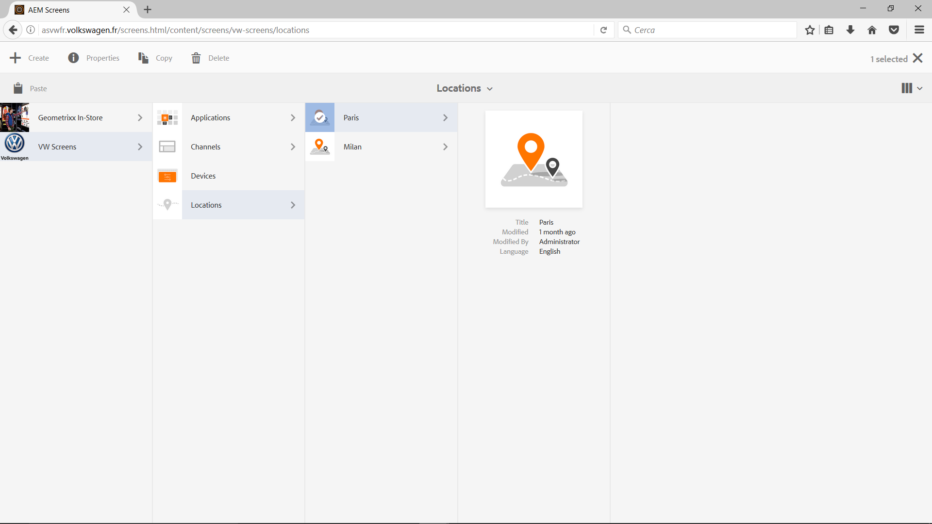
Click
Select
Click
Click

Slide 5
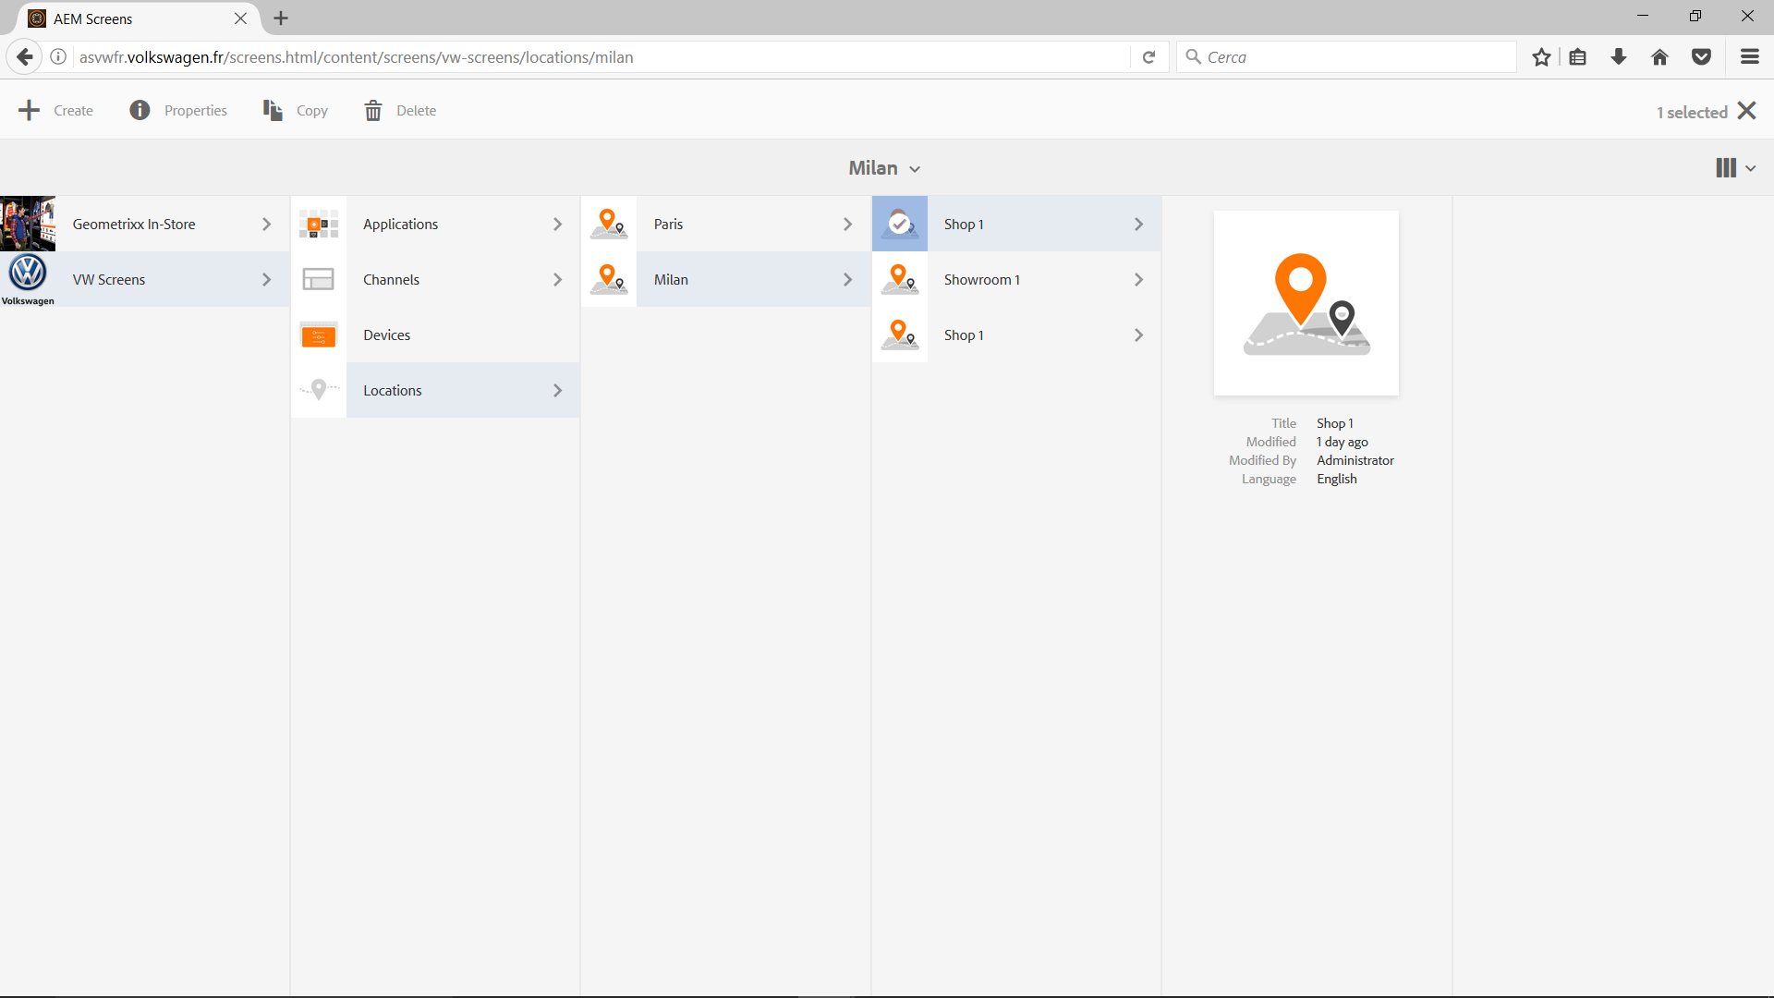
Click
Select
Click
Click
Click

Slide 6
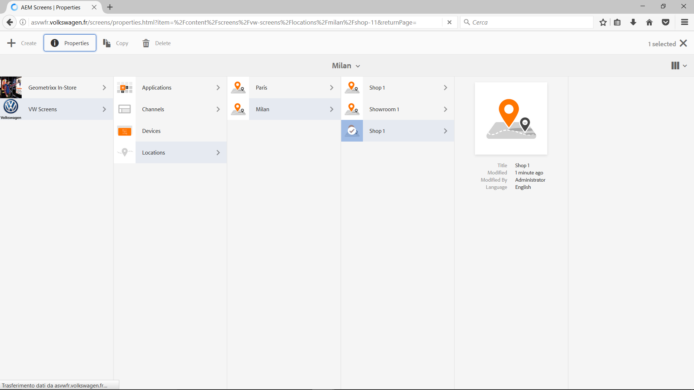
Click
Click
Click
Click
Click

Slide 7
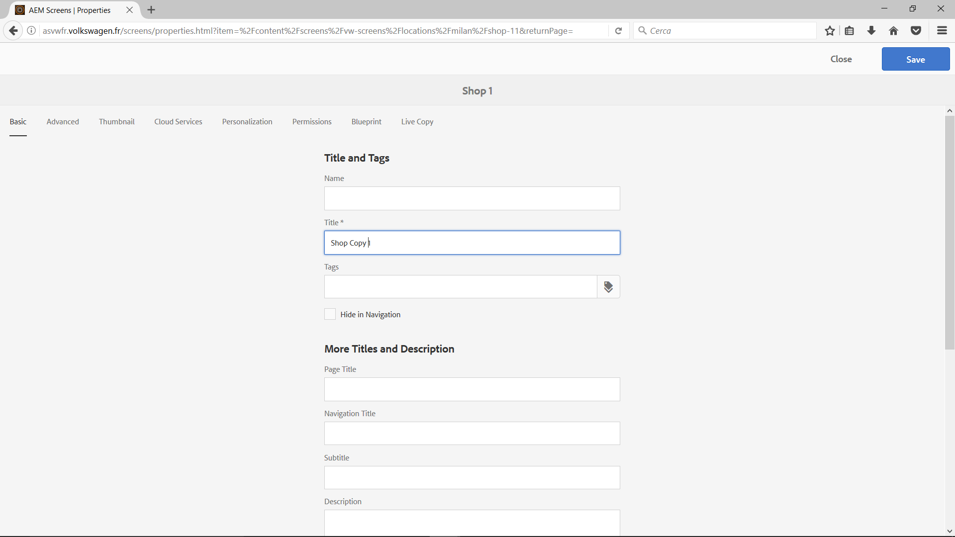
Click
Input
Select

Slide 8
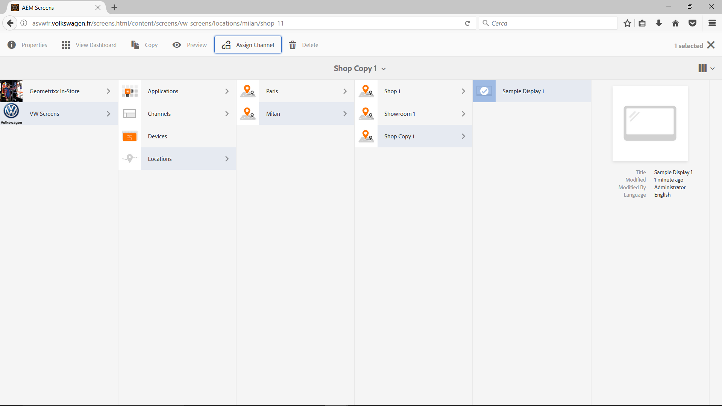
Click
Click
Select
Click
Click
Click

Slide 9
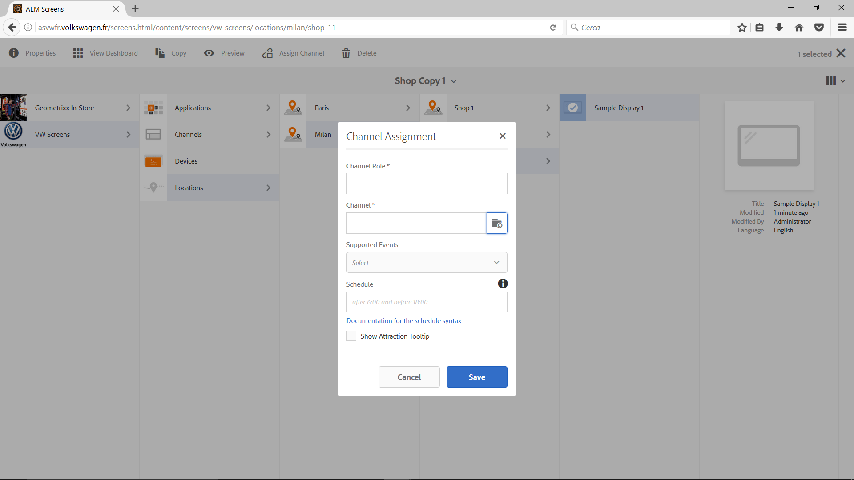
Select
Input
Select
Select

Slide 10
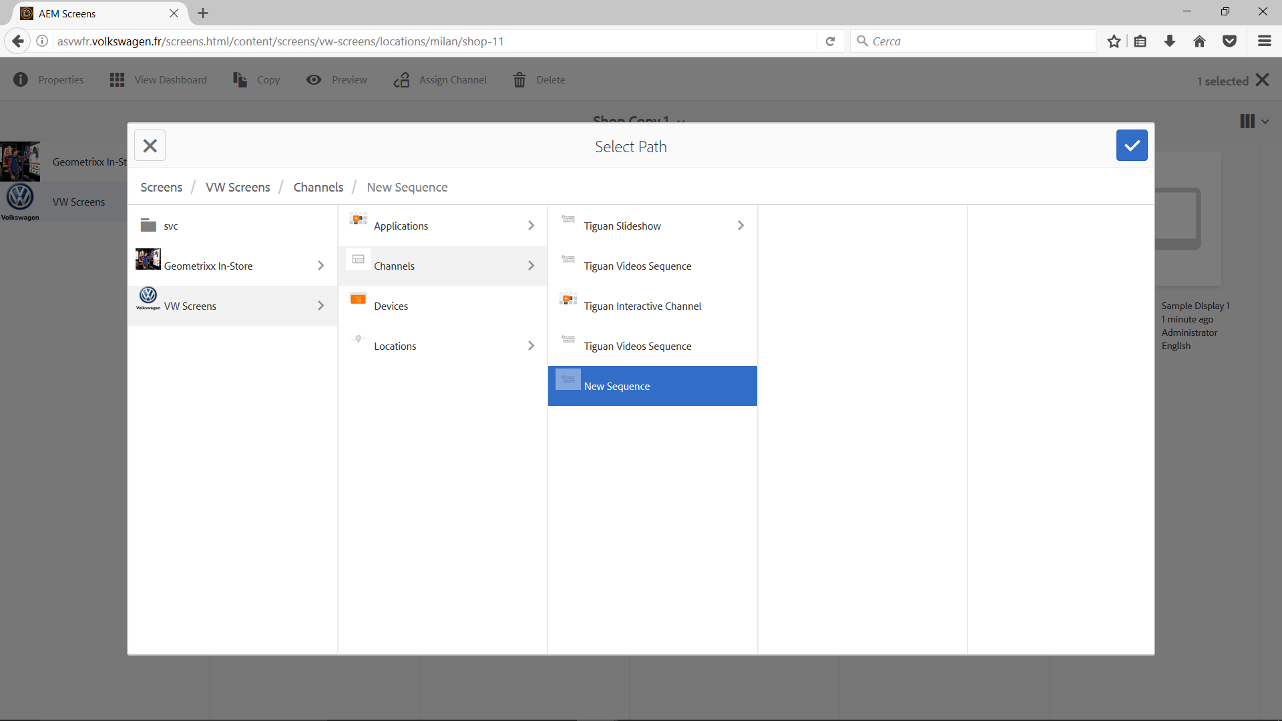
Click
Click
Click
Click

Slide 11
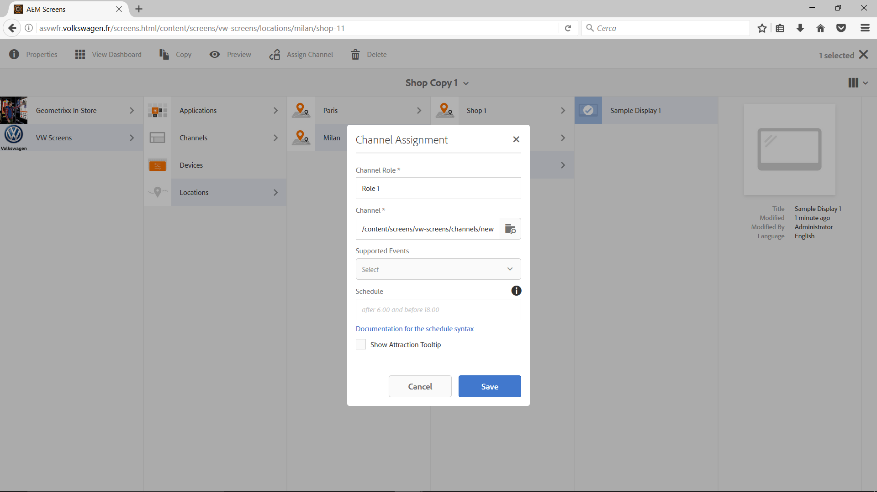
Click

Slide 12
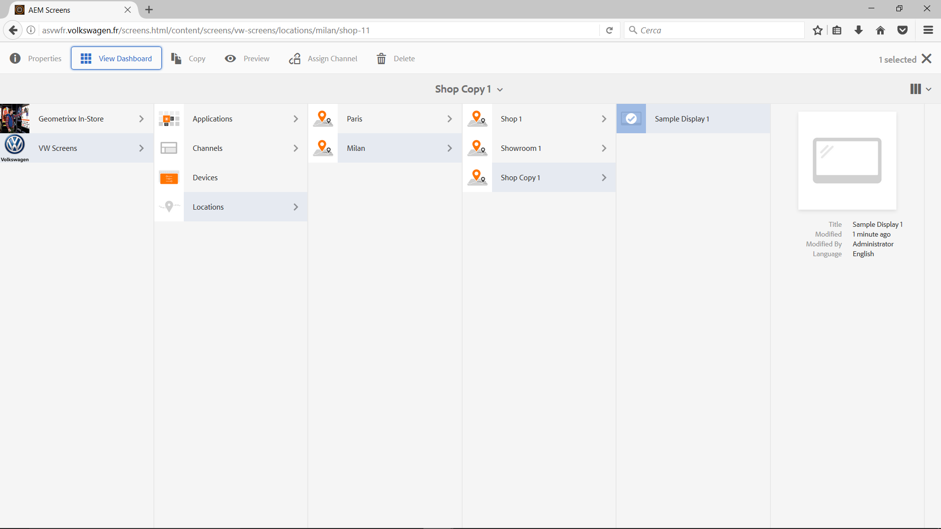
Click
Click
Select
Click
Click
Click

Slide 13
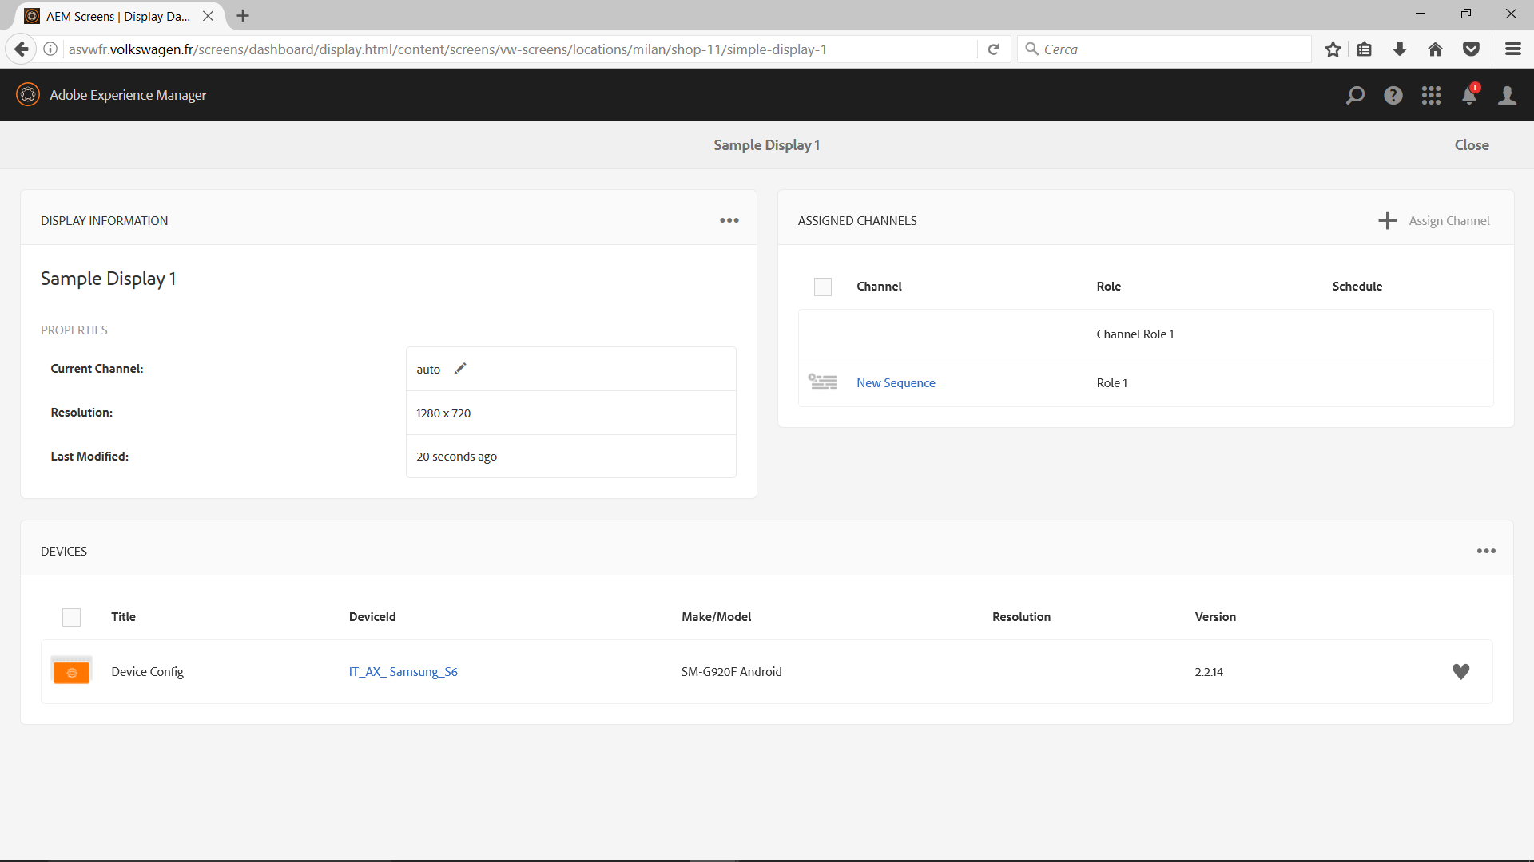
Click

